Slide 1
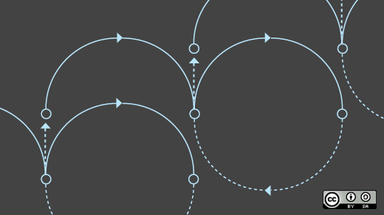

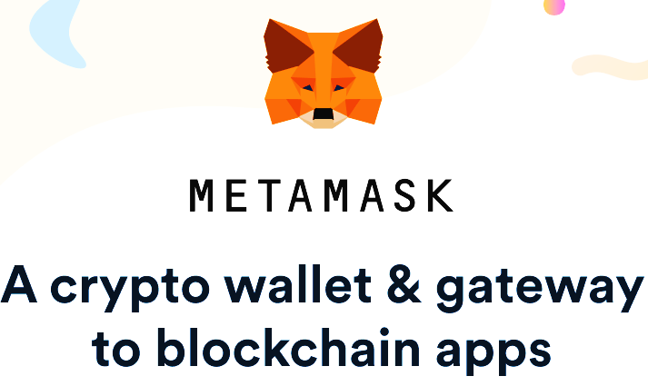


]
A Infrastructure like no other is possible just because of . . . . . .

Slide 2
Over that what we have made is the miracle you’ve been waiting for…….
BUT
What you get from them is the right platform to perform on

Slide 3
Publicate

